Slide 1
Module 1 – Overview
AIS Application Development 2.0 (AD 2.0 - A UMF Delivery Process)
Notes:
Welcome to the AD 2.0 Method course. This first section of the course, Introduction to Application Development 2.0 Method, contains one module. This module provides an overview of the Application Development (AD) 2.0 delivery process, phases, work products, and key outputs. It also introduces the standard tools and key assets that support AD 2.0. In order to receive credit for this section, you will need to complete this module.

Slide 2
Introduction and objectives
In this module, we will cover:
What is the Application Development (AD) 2.0 Delivery Process?
When should AD 2.0 be used?
AD 2.0 Delivery Process Contents; phases and key outputs
AD 2.0 support for iterative and incremental development
Standard tools and key assets supporting AD 2.0
By the end of this module, you should be able to:
Describe Application Development 2.0
Identify the phases of AD 2.0 and the purpose and objective of each
Identify the key work products by phase and their key characteristics
Describe how key work products evolve from requirements through delivery
Describe the development lifecycle within AD 2.0
Identify standard tools and key assets by phase
Identify how the method can be used to address areas of project risk
Describe by role, the responsibilities across the lifecycle
Describe how specific artifacts are developed by key project roles
Describe how to assess the quality and completeness of the work products
Notes:
In this module, we will:
Define the Application Development (AD) 2.0 Delivery Process and how it was developed
Identify when and where to apply AD 2.0
Review the materials contained in the AD 2.0 Delivery Process
Review AD 2.0 phases and key outputs
Discuss AD 2.0 support for iterative and incremental development
Review the standard tools and key assets supporting AD 2.0
And now let’s talk about what AD 2.0 is…….

Slide 3
What is AIS Application Development 2.0 (AD 2.0)?
AD 2.0 is the new standard delivery process to be used for AIS application development projects.
AD 2.0 integrates the best of the Custom Application Development (CAD), Service Oriented Modeling and Architecture (SOMA) for AD, project management and Full Life Cycle Testing into a new global application development delivery process.
AD 2.0 simplifies the work breakdown structure to focus on key elements of the AIS application development process including business requirements analysis, user experience, architecture, technical design, and development.
AD 2.0 preserves essential aspects of SOMA for the services design and development.
AD 2.0 additionally leverages existing content in the areas of Project Management through use of GBS PM standard practices.
Notes:
AD 2.0 is the new standard delivery process to be used for AIS application development projects. In the past, a variety of delivery processes have been used for our application development projects. AD 2.0 integrates the best of the Custom Application Development (CAD), Service Oriented Modeling and Architecture (SOMA) for AD, project management and Full Life Cycle Testing into a new global application development delivery process.
One of the main goals for the creation of AD 2.0 was to try and keep the method simple in order to make it’s adoption and use in solution delivery as efficient as possible for our practitioners. AD 2.0 simplifies the work breakdown structure to focus on key elements of the AIS application development process including business requirements analysis, user experience, architecture, technical design and development
Additionally, AD 2.0 preserves the essential aspects of SOMA for services design and development. In other words, the technical aspects of SOMA that pertain to the architectural design and implementation of Services have been incorporated into AD 2.0.
we also leveraged existing content in the areas of Project management through the use of the GBS PM standard practices we addressed which contain the required project management tasks and work products as identified by our GBS Delivery Excellence organization.

Slide 4

What has changed?
AD 2.0 Delivery Process replaces CAD, Single Release CAD and SOMA for AD as the application development standard method for AIS.
AD 2.0 uses the CAD phase names which are widely known and understood across GBS.
AD 2.0 has a simplified work breakdown structure with less levels, activities, tasks, and deliverables.
Notes:
So….>What has changed?
The AD 2.0 Delivery Process has replaced CAD, single release CAD, and SOMA for AD as the application development standard method for AIS.
We have minimized the elements and levels of detail within AD 2.0 but we have reused the CAD phase names so that the content is more familiar to practitioners that have used CAD in the past. The difference now is that you will see a simpler version of the overall approach than before.
We have cut down on the number of levels of activities in the Work Breakdown Structure and have limited the number of low level activities.

Slide 5
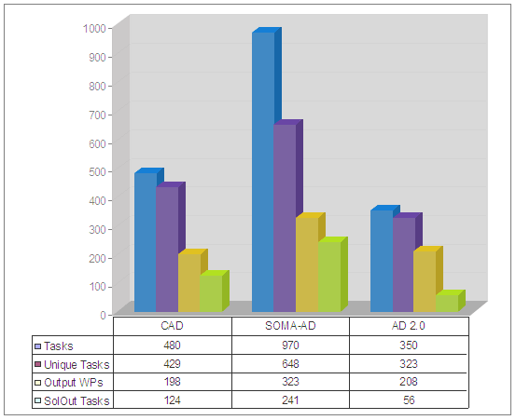
In AD 2.0 achieved significant simplification of the process
In AD 2.0 we have achieved significant simplification of the process through reduction of Work Breakdown Structure (WBS) elements and work products.
Compared to SOMA-AD, AD 2.0 has:
  64% fewer tasks overall
  50% fewer unique tasks
  36% fewer output work products
  77% less tasks in Solution Outline (called Identify in SOMA-AD)
Notes:
This chart summarizes the success we had in working to simplify AD 2.0. The set of bar charts represents the various delivery processes mentioned earlier. You will see CAD on the left, SOMA for AD in the center, and AD 2.0 on the right. If we compare AD 2.0 to SOMA for AD we have 64% fewer tasks through out entire life cycle, 50% fewer unique tasks, and 36% fewer output work products, part of that is due to the fact that AD 2.0 has a smaller scope than SOMA for AD. When we addressed the work in solution outline, since it is usually done in a time boxed manner, we were able to reduce the tasks in solution outline by 77% from what was in SOMA for AD. It makes the accomplishment of that phase within a time box much more feasible now.
So in summary, you can see that we have achieved significant simplification by reducing the Work Breakdown Structures (WBS) elements and work products!

Slide 6

Agenda
What is the Application Development (AD) 2.0 Delivery Process?
When should AD 2.0 be used?
AD 2.0 Delivery process contents
AD 2.0 phases and key outputs
AD 2.0 support for iterative and incremental development
Standard tools and key assets supporting AD 2.0
1.
2.
3.
4.
5.
6.
Notes:
In this module, we will:
Define the Application Development (AD) 2.0 Delivery Process and how it was developed
Identify when and where to apply AD 2.0
Review the materials contained in the AD 2.0 Delivery Process
Review AD 2.0 phases and key outputs
Discuss AD 2.0 support for iterative and incremental development
Review the standard tools and key assets supporting AD 2.0
And now let’s talk about what AD 2.0 is…….

Slide 7
When and where do we apply AD 2.0?
AD 2.0 (Standalone) | AD 2.0 (with other UMF Delivery Processes) | Other UMF Delivery Processes instead of AD 2.0
Typical custom application development projects Part or all of the application development life-cycle Single or multiple releases SOA or non-SOA approach New development or re-writes | AD Method is base Activities and work products from other Delivery Processes are added as needed: CSI Method Blueprint Package Selection and Implementation IBM Oracle | Agile Development Agile with Discipline Enterprise Architecture Business Architecture Quickstart IT Architecture Quickstart Security and Privacy Core Security Consulting Methodology Enterprise-wide Security Program Identity Administration Design and Implementation Others to be developed
Notes:
On this chart we see the different options to consider for using AD 2.0.
Standalone……
The primary or ‘sweet spot’ is of course custom application development projects. We see most customers wanting a single solution developed with the objective of automating a set of business processes and that is exactly where this delivery process is targeted.
A specific engagement may do all or part of the application development lifecycle. We can select one or multiple phases as needed for an engagement depending where we are in the lifecycle with each client. AD 2.0 is built for single or multiple releases. And we can incorporate Service Oriented Architecture (SOA) or non-SOA technology so the solution may involve service creation for some elements of the solution. The guidance for using services exists in AD 2.0, however if there aren’t any services development requirements, then the delivery process is built for that as well.
AD 2.0 is used for new development and application re-writes.
With other UMF Delivery Processes…..
There may be some cases, as shown in the middle column where AD 2.0 may be combined with other delivery processes via tailoring. For example, often there are times where application development is performed in conjunction with Package Implementation. In this case, tailoring our Complex System Integration Blueprint with AD 2.0 and the appropriate Package Implementation Methods would be recommended.
Using other UMF Delivery processes….
Other UMF delivery processes might be a better fit than AD 2.0 in some cases. For example, if your project is focused on Agile Application Development, Enterprise Architecture or Security and Privacy there are other methods available. The column on the right lists some of the methods available and others will be developed.
The complete set of AIS processes, methods, tools and assets can be found on the AIS PMandT Snapshot. The complete set of GBS Methods can be found on Method web. Links to these sites are listed in the in the wiki for this course.

Slide 8
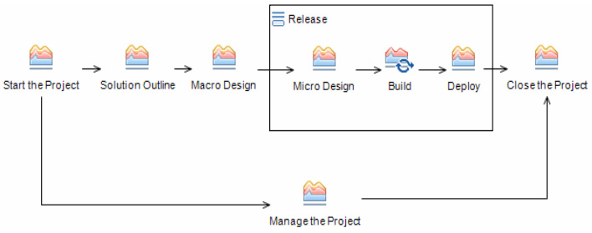

AD 2.0 mapped to our previous delivery processes
Application Development 2.0
(AD 2.0)
UMF/CAD
Solution Outline
Macro Design
Micro Design
Build Cycle
Deployment
Method Adoption Workshop conducted
Confirm Solution Outline
Confirm
Macro Design
Confirm
Micro Design
Confirm Build
Confirm Deploy
UMF/SOMA-AD
Identification
Specification
Realization
Implementation
Deployment
Method Adoption Workshop conducted
Confirm Identification
Confirm
Specification
Confirm
Realization
Confirm Implementation
Confirm Deploy
RUP
Inception
Elaboration
Construction
Transition
Development Case built
Lifecycle
Objective
Lifecycle
Architecture
Initial Operational Capability
Release
Notes:
Let’s have a look at how the phases in AD 2.0 map to some of the more common methods that have been used in the past for Application Development. The mapping to CAD is easy as it highlights the reuse of the CAD phase names in AD 2.0.
The mapping to SOMA-AD is a little different since the Identification phase in SOMA for AD has a broader scope in terms of some interlock with Enterprise architecture. There are also some analyses around the services ecosystems of an industry which aren’t really single solution focused and therefore aren’t in AD 2.0. So the Identification phase of Soma is a much bigger phase than Solution Outline.
At the bottom of the page AD 2.0 is mapped to RUP, which also does not align to AD 2.0 as easily as CAD. However the high-level mapping is,
Inception – this is taken care of with Solution Outline in AD 2.0,
Elaboration – which covers Macro Design and part of Micro
Construction- this covers part of Micro and all of Build
Transition – this phase is mapped pretty closely to Deploy in AD 2.0.

Slide 9
Agenda
What is the Application Development (AD) 2.0 Delivery Process?
When should AD 2.0 be used?
AD 2.0 Delivery process contents
AD 2.0 phases and key outputs
AD 2.0 support for iterative and incremental development
Standard tools and key assets supporting AD 2.0
1.
2.
3.
4.
5.
6.
Notes:
In this module, we will:
Define the Application Development (AD) 2.0 Delivery Process and how it was developed
Identify when and where to apply AD 2.0
Review the materials contained in the AD 2.0 Delivery Process
Review AD 2.0 phases and key outputs
Discuss AD 2.0 support for iterative and incremental development
Review the standard tools and key assets supporting AD 2.0
And now let’s talk about what AD 2.0 is…….

Slide 10
What is included in AD 2.0
Phases, activities, and tasks which are part of the Work Breakdown Structure (WBS).
Work products
Guidance
Notes:
AD 2.0 is composed of: Phases, activities and tasks which are part of the Work Breakdown Structure; Work Product descriptions, templates and example; Guidance in the form of technique papers, checklists, estimating considerations and other supporting materials. Let’s have a closer look at each of these elements.

Slide 11
AD 2.0 phases
AD 2.0 has 5 main phases and three project management related phases
Notes:
As mentioned earlier when we mapped AD 2.0 to legacy delivery processes, you see here again the 5 main technical phases within AD 2.0.
The primary technical phases start with Solution Outline and run through deploy as shown in the top portion of the graphic. Solution Outline and Macro Design deal with the entire solution and determining what that overall solution will look like.
The release set of phases in the “release Box” includes: Micro Design, Build, and Deploy. These are really meant to address some subset of the entire solution that is identified in the Solution Outline and Macro Design phases. We may have multiple releases such as release 1, release 2 or 3, and so on. Each engagement can determine how to partition the solution into multiple releases, as it makes sense according to client priorities and technical dependencies.
The definition of a release is that the work involved should be usable, implementable units of work. Once we build a release we use the deploy phase to make it available to our intended audience. That audience may grow as we go through multiple releases. So the first release may have a small set of users where as for future releases that number is often much greater.

Slide 12
AD 2.0 has 5 main phases and three project management related phases
Notes:
Here we highlight the 3 project management related phases.
Start the project and Close the project are really bookend phases and are used to start or close the project, regardless of what phases you choose to use inside the technical part of the delivery process.
In the bottom portion of the graphic you see Manage the Project which is really the level of effort kind of tasks which occur throughout the entire lifecycle of the project such as monitoring the project, handling exceptions, manage deliverables, and maintaining the development environment.

Slide 13
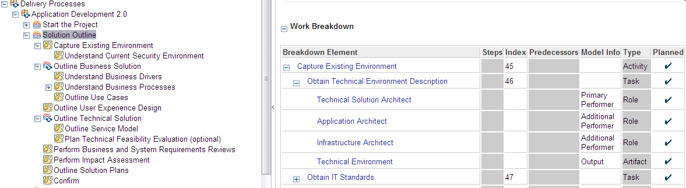
AD 2.0 WBS showing phase, activity, and task relationships
Activity
Task
Roles
Work Product/Artifact
Notes:
A work breakdown structure is a hierarchical structured list of all the project activities, in which the work of the project is broken down into smaller work units to achieve an appropriate level of granularity. This granularity helps to ensure that the full scope of work to be performed is understood.
We have looked at the AD 2.0 WBS phase structure and we can view the more detailed elements within the WBS by expanding an activity within the Solution Outline phase.
As we look at the “Capture Existing Environment” activity, you see some of the tasks that are contained in this activity.
The format shown for the first Task, Obtain Technical Environment Description, is typical of what is seen for all tasks in the delivery process. There are identified roles for who will be performing the tasks. There will always be a primary performer and most times you will also see additional performers that will be assisting in the task.
The output work products from the tasks are identified and if there are input work products these will be listed as well.
Clicking on a specific task will also display a narrative purpose and desciption.
More in-depth exploration of the wbs will occur later in the course.

Slide 14
AD 2.0 work products defined
Work products are used to define and describe the items needed as input or created as output of one or more tasks.
Three types are artifact, deliverable, outcome:
  Artifacts – Specialized type of work product that represents tangible, non-trivial items that are consumed, produced, or modified by tasks. Artifacts may be composed of other artifacts and often serve as a basis for defining reusable assets, for example – ENG 342 Action Log, ART 0515 Component Model.
  Deliverable – Work products used to define the primary outputs that represent value to the client, customer or other stakeholders, for example – DEL 0538 Business Model.
  Outcome - Specialized type of work products used to describe intangible items such as the completion of some set of activities, a result or state, for example – Data Migrated.
Notes:
Work Products are used to define and describe the items needed, as input or created as output of one or more tasks that are the responsibility of a perform role. Within UMF there are over 200 different work products that are comprised of three types which include: artifacts, deliverables, and outcomes. AD 2.0 has used a subset of the total number which are deemed applicable to an application development engagement.
Artifacts are a specialized type of work product that represents tangible, non-trivial items that are consumed, produced, or modified by tasks. Artifacts may be composed of other artifacts and often serve as a basis for defining reusable assets. Some examples are: ENG 342 Action Log, ART 0515 Component Model. The ENG 342 and ART 0515 in the preceding example are work product identifiers which are assigned to all UMF work products except outcomes.
Deliverables are work products used to define the primary outputs that represent value, material or otherwise, to the client, customer or other stakeholders. An example is the DEL 0538 Business Model which is a report that documents the business environment relevant to the solution. The individual parts of this deliverable include: Business Direction (BUS 411), Current Organization Description (ORG 001), Data Model (ART 0519), Process Definition (BUS 309).
Outcomes are specialized types of work products used to describe intangible items such as the completion of some set of activities, a result or state. A key differentiator for outcomes against artifacts is that outcomes are not candidates for harvesting as reusable assets. Outcomes can not have associated templates or examples and are not possible to reuse as assets on other projects. Examples of outcomes include, “data migrated” and “assets harvested”.

Slide 15
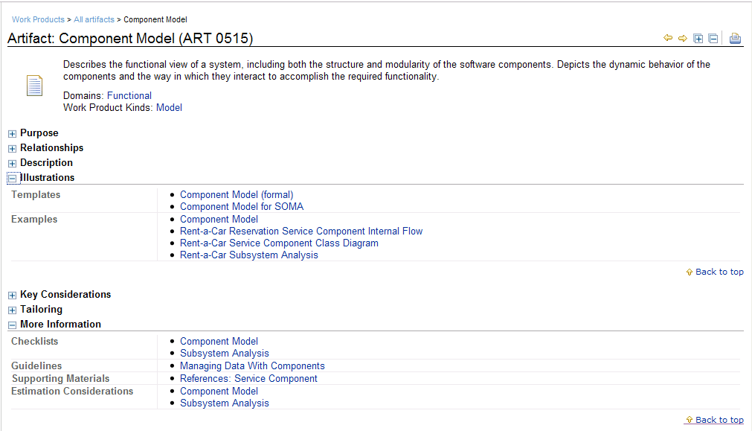
AD 2.0 work product example
Notes:
AD 2.0 includes a significant amount of content to support the development of Work Products. Each Work Product in the Method includes the following content displayed in this Component Model example:
Purpose and descriptions contain narrative information on the purpose and contents of the Work Product
Relationships contains information on the inputs, outputs and roles associated with the Work Product
Illustrations provides links to templates for creating the Work Products along with Work Product Examples
Key Considerations and Tailoring provide high level guidance for creating the Work Products
More Information includes links to Checklists, Detailed Guidelines or Technique Papers, Estimating Considerations and other supporting materials

Slide 16
Agenda
What is the Application Development (AD) 2.0 Delivery Process?
When should AD 2.0 be used?
AD 2.0 Delivery process contents
AD 2.0 phases and key outputs
AD 2.0 support for iterative and incremental development
Standard tools and key assets supporting AD 2.0
1.
2.
3.
4.
5.
6.
Notes:
In this module, we will:
Define the Application Development (AD) 2.0 Delivery Process and how it was developed
Identify when and where to apply AD 2.0
Review the materials contained in the AD 2.0 Delivery Process
Review AD 2.0 phases and key outputs
Discuss AD 2.0 support for iterative and incremental development
Review the standard tools and key assets supporting AD 2.0
And now let’s talk about what AD 2.0 is…….

Slide 17
AD 2.0 phases mapped to our previous delivery processes
Application Development 2.0
(AD 2.0)
Notes:
We reviewed phase layout earlier and here this slide is shown again without the mapping to other Delivery Processes. It shows the end to end lifecycle by phase of AD 2.0.
Let’s now take a closer look at each phase within AD 2.0 to understand phase objectives, characteristics, and outputs.

Slide 18
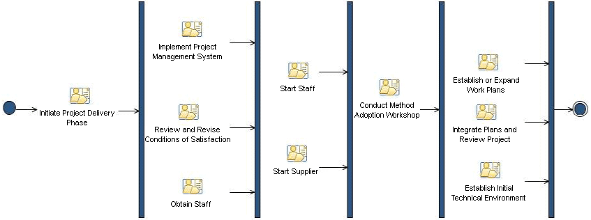
Start the project
Objectives of Start the Project:
Ensure that project has been set up in the needed operational and financial systems, for example CLAIM, billing, and others
Assign the resources needed to staff the project – IBM and Supplier
Ensure plans are at a sufficient level of detail to control project execution and the needed resources are in place
Project team orientation
Establish the tooling environment needed for the project
Confirm client conditions of satisfaction
Characteristics of Start the Project:
Work must be done during short time frame at start of the project with Project Manager (PM) as primary resource
Project team quickly ramps up throughout this activity
Baseline plan and conditions of satisfaction are confirmed with the client
Key outputs of Start the Project:
Technical environment implementation planned
Project management system implemented
Staff identified and started on project
Conditions of satisfaction reviewed / revised as needed
Work plans established
Suppliers identified and integrated into project
Delivery Method Adoption Workshop conducted
Notes:
The first phase, Start the project comes from GBS PM minimal practice and is standardized for normal project management activities.
The objectives of Start the project are listed for your review. The activities in this phase are followed to successfully begin an iteration, phase, sub-project or project by ensuring that the various plans are at a sufficient level of detail to control the execution of the project and the necessary resources are in place.
During Start the Project we establish the technical environment and supporting tools necessary to produce the project deliverables, and get the project teams and subcontractors underway.
Note that the Start the Project work is usually accomplished during a short time frame and the Project manager is the primary role for ensuring key outputs are created. The Project Team quickly ramps up throughout this phase and the overall project plan is baselined and conditions of satisfaction are confirmed with the client.
Key outputs from this phase mirror normal outputs prior to any technical work done on a project. As a review these include:
Technical environment implementation planned
Project management system implemented
Staff identified and started on project
Conditions of Satisfaction reviewed/revised as needed
Work plans established
Suppliers identified and integrated into project
Delivery Method Adoption Workshop conducted

Slide 19
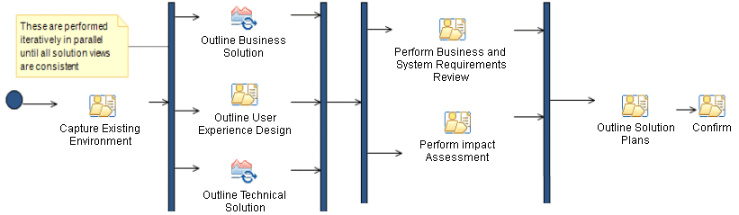
Solution Outline establishes initial solution design and plan for implementation
Objectives of Solution Outline:
Understand solution complexity
Understand client environment
Develop initial solution design linked with client business objectives
Develop plan to complete design and high-level plan for implementation
Validate and refine design and implementation costs
Understand impact of solution on the client – due diligence
Allows client or IBM to make a go / no-go decision with minimal investment and significant confidence
Identify areas of project risk and complexity and develop risk management plans
Characteristics of Solution Outline:
Typically time boxed
May be done with B&P funding or as a ‘feasibility’ engagement
Can have significant resource and visibility issues
Key outputs of Solution Outline:
Current environment including identification of current functional capabilities
Business requirements in form of process models complete to level 3 (as required to identify services and use cases
Identification of candidate services
UI prototypes and high level interactive models
Identification of functional and qualitative requirements including Use Case identification
High level architecture of solution, including a component, operational, and (conceptual) data model
Solution release plans
Business and system requirements review result
Notes:
Solution Outline is the first technical phase.
In the case of solution outline we have the preliminary task to capture the existing environment. We need to understand what the client’s standards are and what kind of technical environment is in place, what their expectations might be for how the solution will fit into that environment, and what kinds of existing systems there are to interface with.
You’ll notice that there’s a pattern that we follow for most of these design phases…..where we have an iteration which is a set of activities that work together to define different aspects of the solution. These work iterations are typically staffed by different practitioners. So we usually have a business aspect, seen as Outline Business Solution that is mostly performed by business analysts…We have the user interface aspect, “Outline User Experience Design”, mostly staffed by User Experience professionals, and we have Outline Technical solution which is staffed by architects or application developers. The practitioners doing these activities need to work together, in order to make sure these solution aspects are all consistent with each other. A lot of times you make decisions in architecture or decisions in design that may impact the requirements that you defined as part of the business solution. This work is iterative and the people have key collaboration points to develop these views in a way that end up being consistent and supportive of each other.
These three activities are completed at a high level (remember this is solution outline) …but still at a level sufficient for us to understand what the cost basis is to move forward and complete the solution. We also want to make sure we identify any unusual challenges or complexities that we should consider in our planning going forward. An example would be needing to plan for the development of a technical proof of concept in order to socialize a new technology in our client’s environment.
We now move to the next set of tasks. We perform the business and system requirements review, which establishes the first 2 System Engineering checkpoints. And then we Perform Impact Assessment which is really about due diligence, both from a business and a technical viewpoint.
Once we get through those reviews and assessments, we do solution planning for the next phase, such as test strategy and an initial cut at a release plan. And at that point we should have enough information to much more accurately estimate the cost of the remaining phases.
We would typically recommend that Solution Outline be done in a time boxed fashion as this initial design takes into consideration the complexity of the required solution and discovers where the problems are. So we can decide with the client at end of the phase whether to continue with solution development and what the costs are.

Slide 20
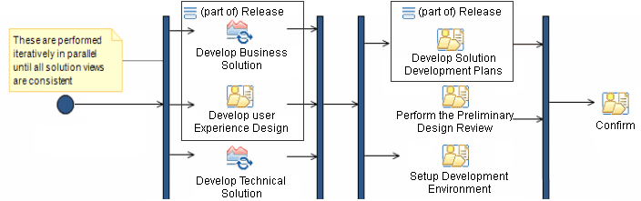
Macro Design creates a stable cross release architecture design and determines release sequencing and dependencies
Objectives of Macro Design:
Develop solution architecture at logical and physical level
Prototyping and feasibility evaluations are performed to validate user interface and complex or unique architectural patterns
Determine product selections for infrastructure components (build versus buy at component architecture level)
Create logical design for information components (databases)
Refine and extend requirements, including Non Functional Requirements (NFR) as they relate to architectural trade-offs and use case scenarios across the entire solution
Create environment for on-going release development
Refine solution release estimates going forward, with best estimates for earliest releases
Characteristics of Macro Design:
Planned for in detail, and closely tracked for actual progress
Often conducted by organizationally and geographically dispersed teams
Often done as an overall solution design engagement, and sometimes coupled with the build of the first release
Key outputs of Macro Design:
Functional and qualitative requirements including measurable outcomes and Use Case scenarios
Fully specified Service Model including service characteristics and dependencies
System-wide architecture design consisting of component, operational, and logical data models
Build vs. buy decisions on embedded solution components
Detailed Micro Design and construction plans
Functioning development environment
Wireframes of UI, HTML for UI, UI testing
Preliminary Design Review results
Notes:
Now onto Macro Design. It has a different objective…..where Solution outline was about understanding complexity, Macro Design is about creating the architecture for the solution and creating the platform that the solution can be implemented on and that is viable for all releases of the solution. We want to ensure that we do not get partway through the solution development and discover some major architectural component or some major new requirement that would change previous design work and create unanticipated costs. We want to work at a detail level and therefore this phase is not really time boxed. Instead it is more effort driven.
You will see the same three aspects at the front of this phase that we talked about in Solution Outline. We look at the business solution, the user experience design, and the technical solution. As part of the business solution in solution outline, we developed process models and looked at the existing processes that the organization is currently performing. At this point we are talking more about services and use cases so this is a matter of filling in the use cases that happen within the scope of the processes that we defined previously.
In user experience design we had previously done some sort of UI prototype, but now we’re at the stage where we really want to nail down what the UI is going to look like. How many screens are involved, what the navigation flows are from screen to screen, and what type of devices the users are going to need to access the system and what type of conceptual capabilities the users have to deal with user interface complexities.
Develop Technical Solution in this phase is mostly about architecture. We want to develop a fairly detailed functional and operational architecture so we understand what we have to build, how it is going to run, what the quality of service objectives are we can meet for this particular architecture and whether or not there are additional costs or possible negotiations on requirements for these kind of things. And once again it’s a collaborative effort among the roles for these three activities.
Once the designs are complete and they all work together and have been reviewed and determined to be viable, then we come to the next part of Macro Design where we have the preliminary design review. This main purpose is to determine whether or not the architecture that we have developed satisfies all the requirements that have been identified, in other words whether the solution is complete in terms of not having unaddressed requirements. We should ensure that the solution is both efficient and complete. Those are the key criteria here. Efficiency in this regard means whether the solution has components or functions which cannot be linked to accepted requirements, these would represent work that may not contribute to client satisfaction.
Next we develop solution development plans which is planning for the remaining phases. There are a lot of iterations coming up so we need plans that help us monitor the execution of those iterations and helps us define the goals so that we are able to track the progress. Allowing iterations to proceed without understanding the goals to measure progress against along the way is a good way to lose control of a project’s time line.
Next is Set-up the development environment activity. This activity really creates the development environment for the developers to work in. The idea is whatever the development environment is and how dramatic a break it is from what the client currently has, then that would determine how trivial or detailed this activity becomes. The important point is that the correct development environment must be created early in the lifecycle that meets the engagement team’s requirements for all releases.

Slide 21
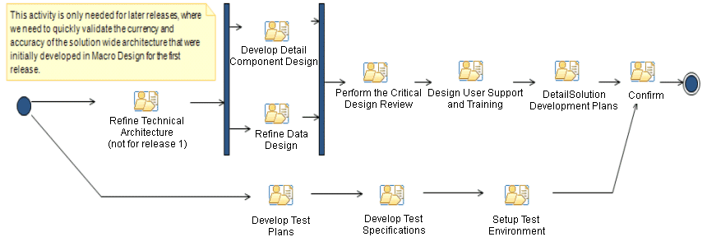
Micro Design creates solution release specifications for all aspects of the development effort to follow
Objectives of Micro Design:
Create a complete set of screen and application designs and specifications as needed to build a solution release
Create specifications to fulfill training needs for users and operators of the application
Finalize testing plans as well as test suites needed for release validation and acceptance
Complete planning for release build by identifying build scripts and team / component programming cycle iteration assignments and objectives
Characteristics of Micro Design:
Team typically increases in size significantly in this phase, and reaches maximum geographic dispersion
Work plans are detailed and closely monitored to evaluate progress
High degree of parallelism between various aspects of architecture and design
Key outputs of Micro Design:
Complete specifications for all UI and custom component construction
Specifications for all required testing environments, user training and support materials
Plans and processes for all builds
Critical Design Review results
Notes:
In Micro Design, the work pattern starts to change somewhat. First of all we come into Micro design and there is an Activity called Refine technical architecture and noted: ‘not for release 1’. This is due to the fact that in release 1 we just left Macro design where the architecture was built. In release 1 we would not expect to refine it right away in Micro Design. We would expect that the architecture that was built in Macro should be sufficient to see us through the first release without any kind of extensions. But in the future there may be things we need to modify in the architecture, such as some future release that may incorporate a new kind of device such as a smart phone which the client’s customer may use to place orders. In that example our solution may require some new architectural components particular to that kind of device. So there is no need to design that in macro design. We would defer it to the release where we need that functionality and do it in Micro Design. So it’s better to defer those type of decisions/changes to the release where they are applicable. Those are the kinds of things that will occur in Micro. In summary, this task Refine Technical Architecture should not imply redesigning the architecture, instead it is more about incremental changes that might be needed by functionality unique to that release.
These next two activities go together, Develop Detail Component Design and Refine Data Design. Detail Component design is really about program specifications. What are the specifications for the things we have to build for this release. And the data design is the database that supports those component specifications. In previous phases up to this point, we have been doing things like conceptual data model and logical data model but at this point we need to build an actual database schema.
Once that is done, we actually have our low level design for this release of the solution completed. So then we do the follow up kinds of things shown here…..the Critical design review is the Systems Engineering checkpoint that evaluates whether the design is both complete and efficient. We also do the design of the user support and training which should concentrate on this release. We should determine what is needed to train users on for this release and what kind of support materials are needed.
Next, we plan out the remainder of the release phases, particularly the next phase which is the build phase. The build phase has different levels of iterations so planning that out now is important because in the build phase we typically have multiple programming teams working in parallel on different pieces of the solution. We need to know now how those teams are going to be formed, what parts of the solution they are going to work on, and how they are going to coordinate their work to create integrated and testable builds.
And off to the side, we have another set of activities going on that relate to testing. It is the same kind of objective, to produce low level specifications to perform the tests that we define as being necessary to meet the client’s quality objectives.
So we develop test plans, for each different level of testing that we have defined, that document how we’re going test, who’s going to be involved and when it’s going to occur. Test Plans will be completed for system integration testing, system testing, and all other test levels.
Test specifications really consists of the test data, the test scripts, the conditions we expect to see at the outcomes of the various tests. These are the test support materials needed to satisfy these test plans.
And then we set up the test environments. This is similar to what we did in setting up the development environment but in this case it’s for testing. We’ve decided what we are going to test so we need to define what kind of environment is needed in order to run those tests and have the outcomes be representative of what we would expect to see in production. We want to start building these environments at this point so they are ready for the next phase when the tests will be performed.

Slide 22
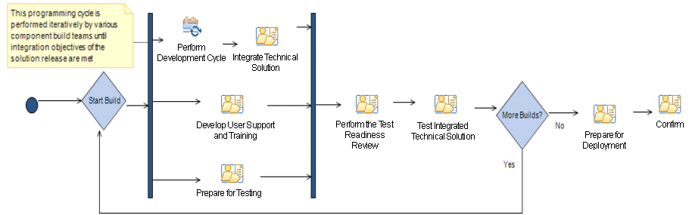
Build creates the physical implementation of the solution release and tests it until the desired level of quality for deployment is achieved
Objectives of Build:
Create all code needed for build (versus buy) elements of release
Install and configure all packaged component functions to be integrated in this release
Create all training and support materials needed for users and operators of the release
Test all solution materials for acceptable conformance to requirements
Prepare all plans and materials required for deployment of the release
Characteristics of Build:
Team size at a maximum with many teams operating in parallel
Teams develop and test their assigned components separately before contributing to an integrated build
Builds are typically tested formally by separate testing team
Final product of the phase is an integrated release candidate of known quality
Key outputs of Build:
Developer tested ‘ready to implement’ custom solution components
Independently tested solution release meeting quality criteria
User support and training materials ready for usage
Operational plans for deployment
Test Readiness Review results
Notes:
In the Build phase the team actually writes code for the solution. There are two different iteration cycles at play here. One is the actual build cycle represented by the two large blue diamonds and the large arrow. The point is that we are going to keep building until we have something that can be deployed. If the tests that are defined can be passed initially, then we would be finished with build. However, in reality it could take many times to complete the actual build. And this is what we should expect and plan for, as this incremental approach has been shown to be the most efficient manner to effectively address solution complexity.
The smaller iteration in this phase is called the ‘development cycle’ and this is where the multiple programming teams are working concurrently on different pieces of the solution. A lot of times we are going to break the solution up into sub-systems or components so those programming teams are actually writing the code for those components. At different points in times the programming teams are going to have things ready to put together into an integrated build. The activity, Integrate Technical solution implies putting together an integrated build across the programming teams of everything that has been accomplished up to that point in time, so that we can demonstrate progress and also see how far we are from completion.
At the same time the programming teams are working we would have other project team members working to develop the user support and training materials that will be deployed with this release as well. We will also be preparing for the testing to ensure that we are ready to begin testing when the appropriate builds are available.
After we exit our parallel development activities, we go to “perform the test readiness review’ which is the Systems Engineering checkpoint for determining whether we are ready or not to do the testing. And then the activity, Test integrated technical solution is where we apply those levels of testing that we defined previously in order to determine if we’ve met the quality criteria for this particular release of the solution to be complete. If we have not, we go back to the development cycle, but if we have, we have what we would call a ‘release candidate’ and we would do Prepare for Deployment activity in order to move to the Deploy phase and roll that release candidate out to our client’s users.

Slide 23
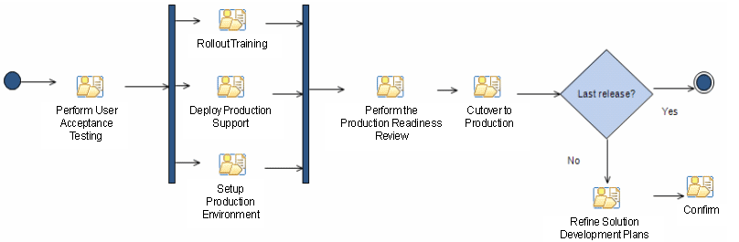
Deploy establishes the release as an operational system in the production environment and starts routine usage
Objectives of Deploy:
Install all necessary components for operation of the release in a production environment
Initialize all components as required to establish the starting point for running the solution
Document acceptance of the release by the engagement owner(s)
Start production operation of the release
Support production solution users and system operators as they begin use of the release
Refine or extend plans and estimates as necessary for subsequent releases
Characteristics of Deploy:
Content in this phase is highly dependent on deployment approach and physical environment characteristics
Significant method tailoring is often required to build a sufficiently detailed deployment work plan
Often the next release work is initiated before the deployment of this release is completed
Key outputs of Deploy:
Solution release accepted by sponsors
Training performed
Solution support and production environments established
Cutover criteria evaluated to be met
Solution release implemented in production
Development plans for future releases updated with lessons learned
Production Readiness Review results
Notes:
And now we move to the Deploy phase, a phase which really hasn’t changed a lot over the years since it represents those basic set of activities you need to do to deploy an application. First of all we do User Acceptance Testing to ensure the system is in fact what we have agreed with our client is to be delivered and that the users understand what the capabilities are for this particular release. Once the client has signed off on the solution, then we are able to start the deployment activities. This includes rolling out the training to train the users, the people in IT, and that the production support organization is set up so users have a place to call for support, in other words, a help desk. We should have production support for IT operations as well.
And we set up the production environment to ensure the hardware and software that are needed to run the solution are all in place and configured properly.
Then we go to Perform the Production Readiness review which is the final System Engineering checkpoint, an extended checklist for things that have to be met in order to move the system into production. Once that is satisfied, we can do the actual cutover to production. If it’s the last release we move on to Close the Project. If there are more releases, then we have the activity, Refine Solution Development Plans. This would be a lessons learned kind of activity where we take what we’ve learned in this particular release and modify our plans for upcoming releases so we don’t make the same mistakes going forward.

Slide 24
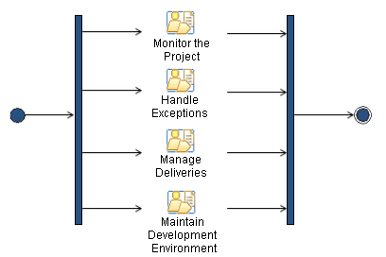
Manage the Project creates activities for monitoring the project, handling exceptions and management of deliveries
Objectives of Manage the Project:
Keep a continuing watch on the project status and financials
Deal with issues, actions, incidents, and change requests
Manage deliveries both to our client as well as from subcontractors
Characteristics of Manage the Project:
Activities which are either time driven or event driven are represented in this phase to accommodate level of effort planning for their accomplishment throughout the life of the project.
Key outputs of Manage the Project:
Status reports
Risk and issue management plans
Change requests
Deliverable approvals
Notes:
Manage the Project phase includes the basic kinds of things that are out of GBS PM practice for monitoring the project, handling exceptions, managing deliveries, and maintaining the development environment.
This phase contains the following activities which occur throughout the lifecycle of the project:
Monitor the Project: Keep a continuing watch on the project status and financials.
Handle Exceptions: deal with issues, actions, incidents, and change requests.
Manage Deliveries: To manage deliveries either to or from the engagement team
Maintain Development environment: Ensure that configuration management procedures are available for use, and that the configuration management activities are performed as needed. Maintaining the development environment consisting of workstations and servers running various operational elements of the solution, development, and testing tools.

Slide 25
Close the Project focuses on the activities and tasks needed to ensure that the project is successfully closed
Close the Project
(IMSP240 and IMSP711)
Objectives of Close the Project:
Confirm customer approval
Harvest project assets
Release staff
Prepare evaluation report to document lessons learned
Characteristics of Close the Project:
This phase will review and assess the completion of all commitments between stakeholders (sponsors or suppliers), including obtaining sponsor feedback, and perform the administrative closure of an agreement (or contract) with a sponsor or supplier, at the end of a project.
Key outputs of Manage the Project:
Conditions of satisfaction
Final acceptance from the sponsor
Lessons learned
Project evaluation report
Project status report
Notes:
Close the Project phase includes activities that need to be performed in order to achieve an orderly shutdown of engagement efforts. Staff are released, work repositories are archived, and actual results are reported on. This phase is typically performed by the Project Manager as the ‘last man standing’ in the engagement team.

Slide 26
Agenda
What is the Application Development (AD) 2.0 Delivery Process?
When should AD 2.0 be used?
AD 2.0 Delivery process contents
AD 2.0 phases and key outputs
AD 2.0 support for iterative and incremental development
Standard tools and key assets supporting AD 2.0
1.
2.
3.
4.
5.
6.
Notes:
In this module, we will:
Define the Application Development (AD) 2.0 Delivery Process and how it was developed
Identify when and where to apply AD 2.0
Review the materials contained in the AD 2.0 Delivery Process
Review AD 2.0 phases and key outputs
Discuss AD 2.0 support for iterative and incremental development
Review the standard tools and key assets supporting AD 2.0
And now let’s talk about what AD 2.0 is…….

Slide 27
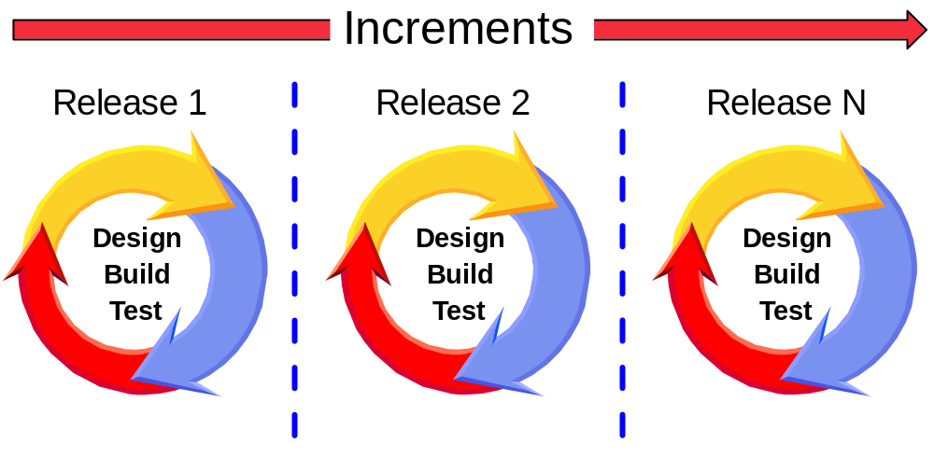
The underlying development approach of AD 2.0 is both iterative and incremental
Iterative – Repeat the cycle of design, build, and test as needed until the full functionality of a particular release is completed
Incremental – Additional functionality is added with each release
Notes:
When we say that AD 2.0 is “iterative and incremental” we are referring to two similar but different concepts relating to system development life cycle processes:
AD 2.0 is incremental in that we develop the full scope of the solution in pieces, or increments, through a scheme of partitioning the full scope into smaller chunks. We do this by understanding the relative business priorities of the solution’s requirements as well as taking into consideration technical dependencies within the solution architecture. In AD 2.0 we call each of these individual increments a ‘release’ and expect to be able to deploy each release to some audience of users (which may be a subset of all eventual users).
AD 2.0 is also iterative in that we often take an approach to developing various aspects of the solution, within a particular release, by cycling through a set of tasks over and over again, refining the output work products as we go, until we reach a level of completion that satisfies our objectives for those work products. In AD 2.0 we have Design Iterations in specific activities of the Macro and Micro design phases, as well as both Build and Development Cycle Iterations in the Build phase.
Both of these approaches allows us to more effectively deal with complexity in the solution by decomposing large problems into smaller subsets, then solving those subsets repeatedly until we have covered the entire solution. In this way we have an opportunity to not only learn from our experiences as we move forward, but also to better measure our progress and improve our estimates for the remaining work in front of us.

Slide 28
First define the overall scope and architecture, then deliver functionality in successive releases
Business and
Technical Value
Release N
Deploy
Solution
Close
Build and
Test
Release
Review
Micro
Design
Release 2
Deploy
Build and
Test
Release
Review
Iterative development
Deliver incremental functionality. Flexible design enables such an incremental delivery
Use appropriate tools in every phase
Elaborate the required work products in every phase
Micro
Design
Release 1
Deploy
Build and
Test
Release
Review
Solution
Startup
Solution
Outline
Macro
Design
Micro
Design
Time
Notes:
In this chart we see an expansion of the AD 2.0 phase diagram to show specific instances of phases in an incremental and iterative delivery engagement. In this example we perform the one time phases of Solution Startup, Solution Outline, and Macro Design once before we enter the incremental release phases comprising Micro Design, Build (which includes testing), and Deploy. The Release Review shown is actually an activity at the end of the Deploy phase. Once the first release is completed, we enter the same set of Release phases again to develop the second release. Inside the Release phases are iterations for design (in Micro Design), and Build and Develop in the Build phase. Not until the final Release increment is complete do we exit the Release phases to complete the engagement in the Solution Close phase.

Slide 29
Benefits of iterative and incremental development
Critical functionality is available sooner
Risks are reduced early
Problems become evident early
Makes more options available
Reduces possibility and impact of estimation error
Balances flexibility and efficiency
Notes:
As briefly noted before, the benefits of incremental and iterative development are many, including:
Critical functionality is available sooner – we can be more responsive to our client’s business needs by prioritizing critical requirements into earler releases, and these releases will complete faster because they aren’t loaded down with less important work.
Risks are reduced early – by tackling complex requirements and designs in early increments and iterations, we can reduce risk more quickly than if we try to do everything at once.
Problems become evident early – when we determine where the more complex areas of a particular solution lie, we can then address these in a more proactive basis than may otherwise occur. Human behavior studies have shown that most people have a natural tendency to defer addressing complex problems, but through identification and aggressive prioritization of complex solution areas we can counteract this tendency.
Makes more options available – in many cases we can address complex situations by identifying alternatives that may provide simpler solutions or by decomposing them into smaller problems whose solutions can be more simply viewed. Iterative development provides a means for doing this through allocating of these alternatives or subsets to different iterations so that we can better work in this fashion.
Reduces possibility and impact of estimation error – by breaking our complete solution into smaller pieces, we can also make our estimates in smaller sets. We also have more opportunities to learn from previous work and applying these lessons to estimates for later increments.
Balances flexibility and efficiency – the more modular work units associated with incremental and iterative development allow for more flexibility in assigning team members to work that best matches their skills.

Slide 30
Multiple release considerations
Increases project overhead
  Drive software to release multiple times
  Retesting, regression testing
  Configuration management for multiple releases
  Extra release support complexity
  Release planning
Small price for the improvement of:
  Visibility
  Status
  Quality
  Flexibility
  Estimation accuracy and risk reduction
TIWSBX | Iterative and Incremental Development | 03/01/2010
Notes:
TIWSBX | Iterative and Incremental Development
On the one hand, dividing the work into multiple releases increases the project overhead. We need time to plan the releases. We have to provide regression tests to ensure that previously tested pieces are still working when we deliver the next software release. We need a version control system, and established configuration management procedures to support multiple releases.
CLICK - On the other hand, this is a small price for the improvement in visibility, quality, early feedback, and last but not least getting more accurate estimations and reduce risks.

Slide 31
Early user involvement is another concept in incremental development
Develop user-centric work products:
  Use Case Model
  User Interface Prototype
  User Interface Design Guidelines
Increase mutual understanding
Make high value, easy to make changes early in the project
Avoid surprises
An involved user is more likely to stay happy
TIWSBX | Iterative and Incremental Development | 03/01/2010
Notes:
TIWSBX | Iterative and Incremental Development
Involving the users early is another advantage of incremental development. We develop user-centric work products like the Use Case Model, User Interface Prototypes, to create high value, avoid surprises in later stages, and keep the users satisfied during the development since they are involved and can see the results of that involvement.

Slide 32
Work products are incrementally elaborated over the project lifecycle
Operational Model
Component Model
Component Design
Use Cases
System Context
Technical Environment
NFR
Start
Project
Solution
Outline
Macro
Design
Micro
Design
Build
Deploy
Solution
Close
Incremental elaboration
Consumed
Notes:
Work products are incrementally elaborated over the project lifecycle. On this chart we see some of the key work product on the vertical axis, and the phases on the horizontal axis. The green bars indicate when the work products are elaborated, while the grey bars indicate that the finished work products are consumed by being input to tasks that produce other work products.
Let’s have a closer look at this incremental elaboration.

Slide 33
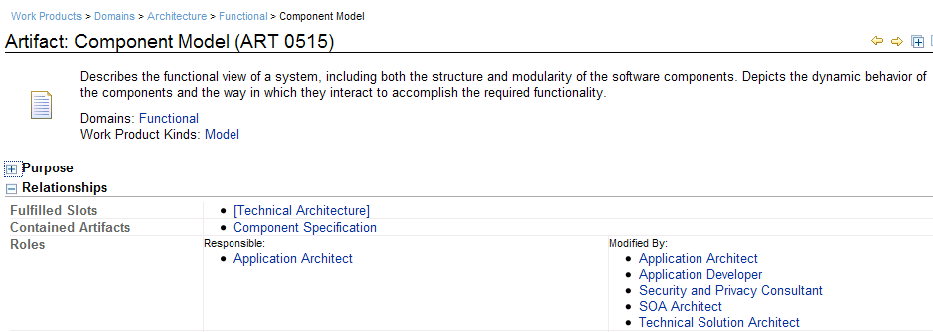

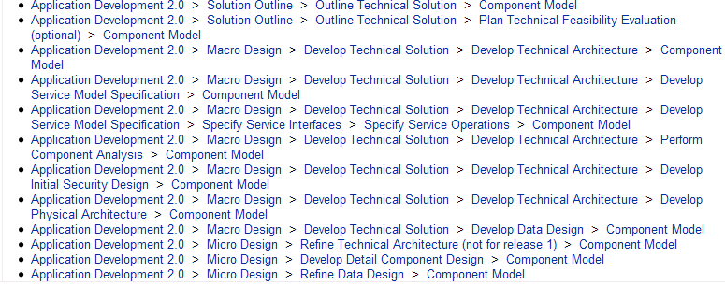
The method’s work product view of incremental and iterative elaboration delete
Notes:
In this example, we can see that the Component Model is output from several tasks within the AD 2.0 Work Breakdown Structure. Its first version is created in the Solution Outline phase, with subsequent elaboration throughout Macro Design as well as updating in three places during Micro Design phase.

Slide 34
Agenda
What is the Application Development (AD) 2.0 Delivery Process?
When should AD 2.0 be used?
AD 2.0 Delivery process contents
AD 2.0 phases and key outputs
AD 2.0 support for iterative and incremental development
Standard tools and key assets supporting AD 2.0
1.
2.
3.
4.
5.
6.
Notes:
In this module, we will:
Define the Application Development (AD) 2.0 Delivery Process and how it was developed
Identify when and where to apply AD 2.0
Review the materials contained in the AD 2.0 Delivery Process
Review AD 2.0 phases and key outputs
Discuss AD 2.0 support for iterative and incremental development
Review the standard tools and key assets supporting AD 2.0
And now let’s talk about what AD 2.0 is…….

Slide 35
AD 2.0 standard tools and assets
Activity | Tool | Asset
Estimating | Software Lifecycle Management (SLIM)
Project Management | MS Project
Activity Management and Collaboration | Rational Team Concert (RTC)
Requirements / Use Cases | Rational Requirements Composer
Legacy System Analysis |  | Analysis and Renovation Catalyst (ARC)
Process Modeling | WebSphere Business Modeler (WBM) IBM Business Process Manager
Software Design | Rational Software Architect
Services Design |  | SOMA-ME ESB Implementation Accelerator
Configuration Management | Rational Team Concert (RTC)
Testing | Rational Quality Manager (RQM) Rational Manual Tester (RMT) Rational Functional Tester (RFT) Rational Performance Tester (RPT) | Test Planning and Optimization Workbench (TPOW)
Model Driven Development |  | Application Development Implementation Toolkit (ADIT)
Notes:
This chart provides a view of the AIS standard tools and assets that are available to support the AD 2.0. Please refer to the AIS PMandT snapshot for the most up to date information. The Tools column reflects the commercial off-the-shelf software products that are used on our engagements. The Assets column lists the key assets that we have developed to drive productivity and quality on our services engagements.
Given asset reuse is a key focus for AIS and GBS we will spend some time reviewing these key assets. We will also briefly discuss the GAIN environment that provide

Slide 36


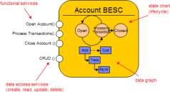



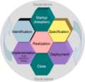
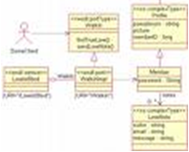

The IBM ADIT automates a significant portion of the project lifecycle
Process Modeling
Object Modeling
Java Code
WBM
BELA
CTE Runtime Services
Core ADAT
Process
Models
R4SC Code
Domain Object
Java project
Service Mediator
Service Contract
Service Result
Automatic
CRUD Services
+
Web project
Access Policies
ADA
Automatic
SCA project
EJB project
ADAT
ADAT UI
Service Modeling
Portal Factory
JSF
RSA
SOMA-ME
Automatic
Service
Models
R4SC Design Patterns
Object
Models
Entry Points
Notes:
Let’s have a closer look at the IBM Application Development Implementation Toolkit.
The Toolkit consists of several value-added components that can be used at various phases in the project lifecycle of a custom Java engagement. It starts right off with business process modeling and it continues throughout the project life-cycle all the way to deployment.
One of the things you may notice are the multiple “entry point” arrows. The “toolkit” will give you the most total benefit if you use all of the components…in all the phases of the lifecycle. But, for various reasons, that might not be possible. In this case, you can still get significant benefit even when you start in service modeling or detailed design.
As part of the Process Modeling activity, we use the Business Entity Lifecycle Analysis (BELA) plug-in for WebSphere Business Process Modeler. BELA enhances the business model by introducing “business entities” and how they are transformed by various business processes (that is: services). So, BELA accentuates the data aspect of business modeling much more than traditional Process Modeling.
From here, we go into Service Modeling. The SOMA-ME tool takes the Process Models from WebSphere Business Modeler as input and automatically generates a Service Model.
Once you are complete refining the SOMA Service model, the next step is to convert the Service Model into a R4SC compliant Component model. SOMA-ME will automatically export this model into Rational Software Architect.
Component Design continues in Rational Software Architect using R4SC to ensure the application layers are decoupled from one-another so changes to one layer do not impact the other layers. Also included in this phase is the addition of the IBM Common Technology Enabler (or CTE) Runtime Services. This is an IBM asset that includes 17 common technical components that are required to implement any J2EE application. Examples include auditing, logging, exception logic, caching, security, and messaging.
From here, we go to the build phase. In the Build Phase we use another asset that is part of the Toolkit – the Application Development Automation Transforms (or ADAT). ADAT will automatically generate up to 70% of the Java Create, Read, Update and Delete code and a good portion of the UI code and database components.
From design/build, we go into deployment. There are several Toolkit components here. One example is the Application Deployment Accelerator, which automates the build of WebSphere environments, something that could take days to set up, manually.

Slide 37
Additional ADIT Components
Component | Benefits
Common Technology Enablers (CTE) JPA Accelerator – Best practices for using the new Java Persistence Architecture (JPA) technology | Saves 5-10 days for teams new to JPA
CTE Application Deployment Accelerator – Provides a framework with many sample scripts, for an automated application deployment and/or resource creation in a WAS environment | Saves 10- 20 days
CTE Batch Execution Services – Provides an environment to execute and control Java batch processing, aimed at customers without WebSphere ComputeGrid. | Saves 600 hours (if no WebSphere Application Server (WAS) CG)
Input Assistant for Web Applications – Provides assistance for user inputs, such as calendar, tab navigation, input masking, number formatting, and so on. It also provides the spreadsheet feature for JSP pages. | Saves 30 person months (if develop it by yourself)
UI Design-to-Code Generators are code generators for web applications based on Struts. It contains two parts: JSP Generator and Form Generator. It can greatly improve the productivity and quality of web application development. | Saves 24 person months (if develop the same on your own)
Data Access Object Generator – Generates Data Access Object (DAO) / Data Transformation Object (DTO) classes based on Data Definition Language (DDL), Database Management System (DBMS) or Java classes. It enforces the separation of business logic and DB access logic to provide better manageability. | Saves 18 person months (if develop the same by yourself)
Notes:
The AD Implement Toolkit contains several additional components that can be used with or without a model driven development approach including:
Best practices for the Java Persistence Architecture
An Application Deployment Accelerator for the WebSphere Application Server environment
Batch execution environment for Java Batch Processing
Input Assistant to help automate the development of input edit and validation logic for web applications
Code generators for web applications based on Struts
And a Data Access Object Generator

Slide 38
The ESB Implementation Accelerator is primarily aimed at large scale enterprise service bus implementation engagements
ESB Asset
Project Mgmt
& Guidance
Architecture
WP’s
Common Components
Design WP’s
Common Components
& Pre-reqs
System Mgmt
& Testing Utilities
ESB Asset
Bill of Materials
System
Context
Auditing
Auditing
Service/Port
Checkers
ESB Asset
Setup Instructions
Architecture
Overview
Core Services
Core Services
Test Tools
Guide
Pre-Built
ESB Demo
High Level
Requirements
Exception
Management
Exception
Management
XML Stub
ESB Tutorial
Logging
XML
Generator
Configuration
Mgmt Guide
Master Test
Plan
Logging
Message
Checker
ICD Template
Component
Model
Performance
Management
MSMQ Adapter
EAI Service Estimator
Schema & DDL
XML
Compare
Sample Plan
Deployment
Units
Standards
DB
Loader
Plug-in Nodes
RAID Log
Operational
Model
Trace
Convertor
DB State
Monitor
Change Cases
Non-Functional
Requirements
WMB
Components
Spreadsheets
Web XML
Stub
Architectural
Decisions
Logical Data
Model
Schema
Validator
Reduce cost:
  The asset encapsulates over 1200 man-days of potential savings and on average saves 500 man-days of effort.
Faster to market:
  The hardened and generic Enterprise Service Bus (ESB) Asset artifacts quick-start ESB developments.
  Time to design, code, and test can be reduced by up to 50%.
Reduced risk and raised quality:
  Encapsulates the experience and lessons learned from delivering ESBs to a number of clients.
  The ESB Asset has been proven, hardened and tested on multiple projects, and is deployed in production for a number of clients.
Notes:
The Enterprise Service Bus Implementation Accelerator is a collection of architecture, design and code artifacts, tools and methods that are used to deliver Enterprise Service Bus implementations based on Websphere MQ and Websphere Message Broker. It includes:
Architecture and Design templates and guidelines
Common components including design and code for auditing, core services, logging, exception management and performance measurement
System Management and Testing Utilities including test tooling and test stubs, installation and configuration guides and procedures, build scripts, problem determination tools and service checkers.
Guidance including estimating guidelines, generalised ESB project plans, asset setup guide and tutorials and training materials.

Slide 39
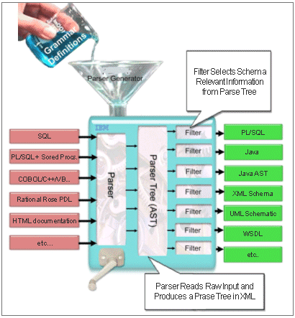
Analysis and Renovation Catalyst (ARC)
ARC provides functions to:
  Analyze and interpret application components / models
  Store the interpretation in an agnostic manner
  Generate code in the new target platform
It operates across platforms, operating systems and languages and can be easily extended to support additional languages and platforms
Supported languages: Cobol, PowerBuilder, SQL, DDL, VB Dot Net, PL/SQL
Transformation Support: CPG to Java Conversion (others in development)
Automates repetitive and time-consuming tasks in the analysis and conversion of legacy applications
  Analysis - 50% labor saving
  Coding - 10-20% labor saving
Notes:
ARC provides functions to:
Analyze and interpret application components/models
Store the interpretation in an agnostic manner
Generate code in the new target platform
It operates across platforms, operating systems and languages and can be easily extended to support additional languages and platforms
Currently supported languages include: Cobol, PowerBuilder, SQL, DDL, VB Dot Net and PL/SQL
Transformation Support: CPG to Java Conversion (others in development)
Automates repetitive and time-consuming tasks in the analysis and conversion of legacy applications
Analysis - 50% labor saving
Coding - 10-20% labor saving

Slide 40
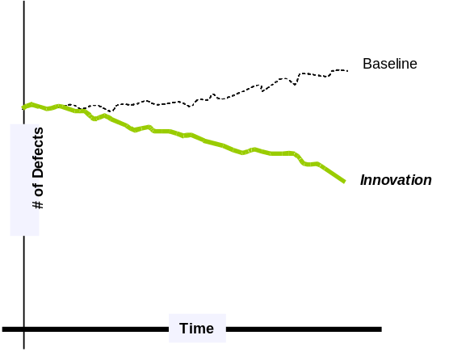
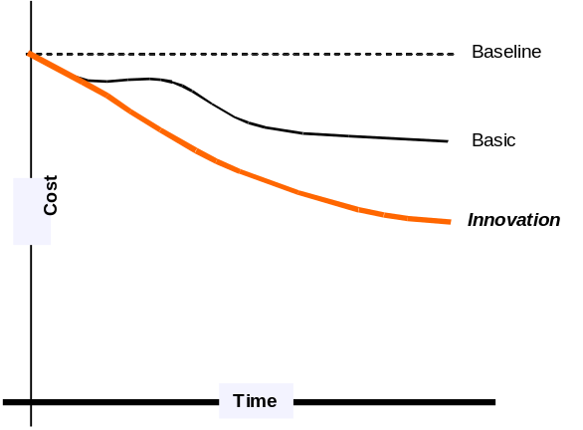
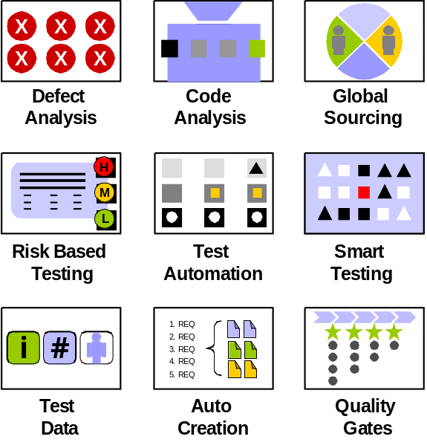
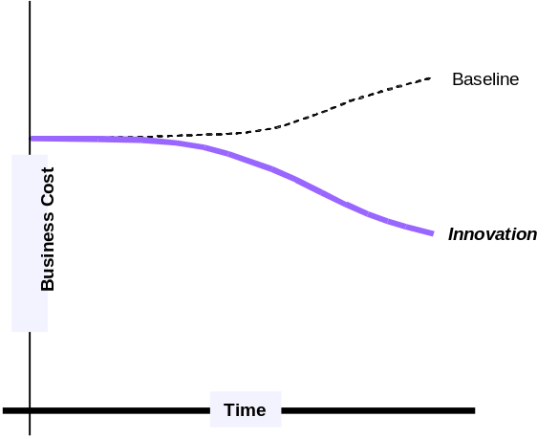
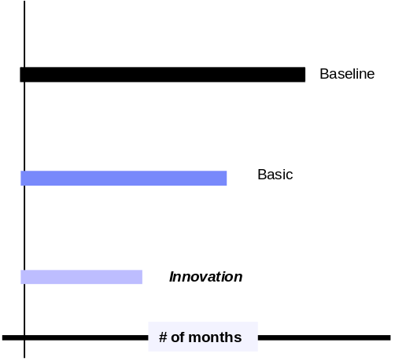
Test Planning and Optimization Workbench (TPOW)
You can access more information on TPOW in Asset Hub
TTQ Dashboard
Quality
Cost
Risk
Schedule
… additional Optimizers forthcoming
Notes:
The Test Planning and Optimization Workbench or TPOW can be used to create and optimize test strategies and test plans in the context of business requirements, risks, testing standards and processes, and the characteristics of the systems under test.
The results of TPOW include test case number estimation, test execution suggestions, initial and residue defect number estimation, test cost estimation, and other testing elements. Empirical test data collected from the test execution can also be used to support in-process test estimation and plan adjustment in TPOW.
TPOW works with Rational tools as well as other testing tools to provide four main areas of functionality to be used at varying points within the sales and delivery of testing services.
Macro planning: a top down approach that helps clients model initial cost and benefits of different testing scenarios and by applying different leading test practices
Micro planning: a bottom up approach that provides guidance to test design activities and execution based on risk or as indicated in macro planning
Project Planning: provides ongoing analysis of the test effort (from planning through execution) to help make the necessary decisions to achieve the organization’s quality, schedule, and cost goals
Intelligence: leverage client projects to provide future project references and support ongoing industry benchmarking

Slide 41
Globally Integrated Network (GaIN)
Shared environment platform:
  Rational Team Concert (RTC)
  Rational Quality Manager (RQM)
  Rational Requirements Composer (RRC)
  Rational ReqPro
  Rational ClearCase
  Rational ClearQuest
Largely provided at no cost to project teams
Sites in Southbury CT, Lexington KY, China, India, and France
Over 600 active GBS projects
Southbury
France
Lexington
Dalian
Bangalore
Legend:
Active Sites
Administrative Access
Notes:
IBM Business Consulting Services
© Copyright IBM Corporation 2007
The Globally Integrated Network or GAIN is shared hosting environment that provides most of the Rational Server based to project teams. If the standard shared environments and connectivity is used there are no costs to the project team.
GAiN sites are located in key locations around the world. The GAiN web site provides complete information on the products available and how to request access. A link to the GAiN website is contained in the wiki for this course.

Slide 42
Summary
Now that you have completed this module, you should
be able to:
  Define the Application Development (AD) method
  Identify when and where to apply the new AD method
  Identify some of the items included in the method (for example, WBS, work products, deliverables, and others)
  List the AD method phases
  Identify key outputs by phase, purpose, and description
  Describe the tools and assets to be used in conjunction with AD 2.0
IBM Confidential
© Copyright IBM Corporation 2011
Notes:
Now that you have completed this module, you should be able to: Define the Application Development (AD) Method; Identify when and where to apply the new AD method; Identify some of the items included in the method (for example; WBS, work products, deliverables, and others); List the AD Method Phases; Identify key outputs by phase, purpose, and description; Describe the tools and assets to be used in conjunction with AD 2.0.

Slide 43
Thank you
IBM Confidential
© Copyright IBM Corporation 2011
Notes:
This completes AD 2.0 Method course, Section 1, Introduction to Application Development 2.0 Method. There are no additional modules in Section 1.
The course provides a practical understanding of how to use the AD 2.0 Method on an actual engagement including phases, activities, work products and best practice techniques in four sections: The Business Domain (section 2), User Experience Domain (section3), Technical Domain (section 4), and Test Domain (section 5). In order to receive credit for these sections, you will need to complete all four sections.
Thank you!

